Slide 1
CRYPTOCURENCY

Slide 2

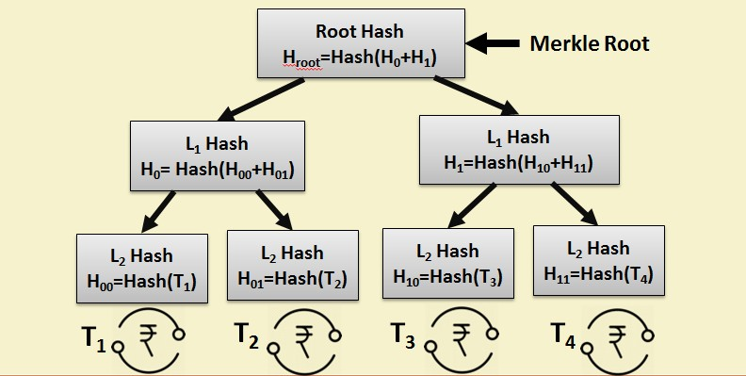
2

Slide 3
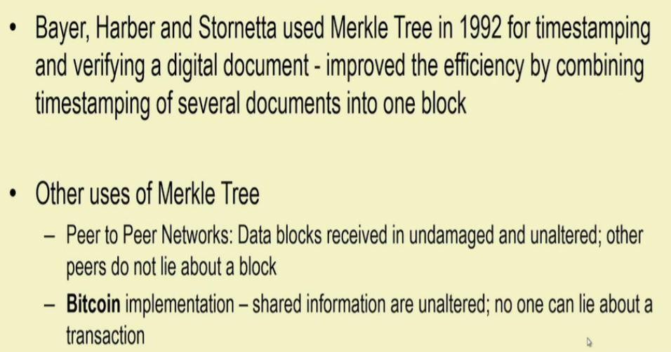

Slide 4
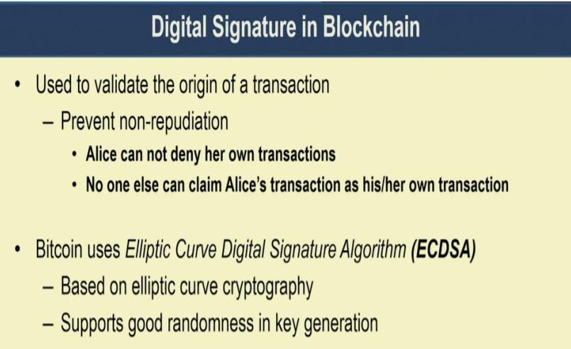

Slide 5
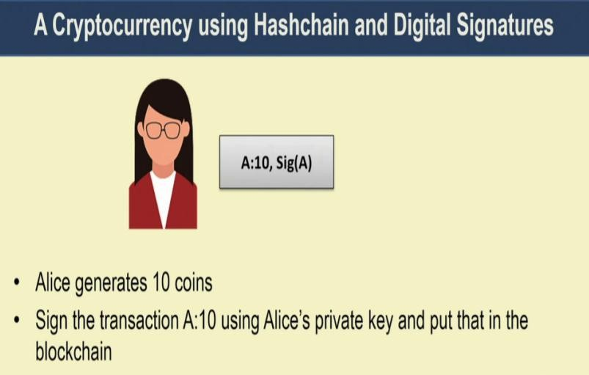

Slide 6

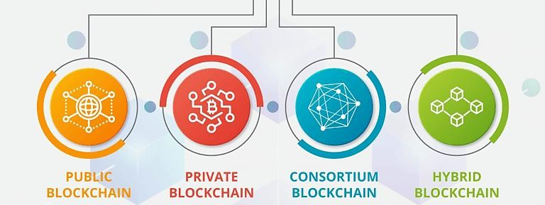

Slide 7

🞂 It is a digital currency in which cryptography techniques are used to regulate the generation of units of currency and verify the transfer funds.
🞂 Decentralized i.e. operates independent of any central authority or individual.
🞂 The supply of money is regulated by software and the agreement of users of the system.
🞂 Trust based on peer to peer consensus
🞂 Transactions are irreversible

Slide 8

 | Conventional currency | Cryptocurrency
Type | Real | Virtual
Intermediates | Yes | No(Peer to peer)
Portability | Yes(except too much cash) | Highly portable
Durable | Moderate | Highly durable
Acceptance | National | Global

Slide 9

 | Conventional currency | Cryptocurrency
Secure | Moderate | High
Scarce | Low | High
Decentralized | No | yes
Smart | No | yes

Slide 10

🞂 Fast and cheap
🞂 Easy to use
🞂 Free to transfer and hold
🞂 Decentralized control
🞂 Privacy and Security
🞂 Transparency is maintained through public ledger system.
🞂 Reduced Fraud

Slide 11
Forking: Duplication from existing Blockchain
Hard Fork: Not Backwad compatible example: Bitcoin Cash Fork
Soft Fork: Allow both .

Slide 12
Decentralised
Form of existance
Limitted
Global Access
Anonymity and Transperency
Impossible to duplicate
Irreversible

Slide 13
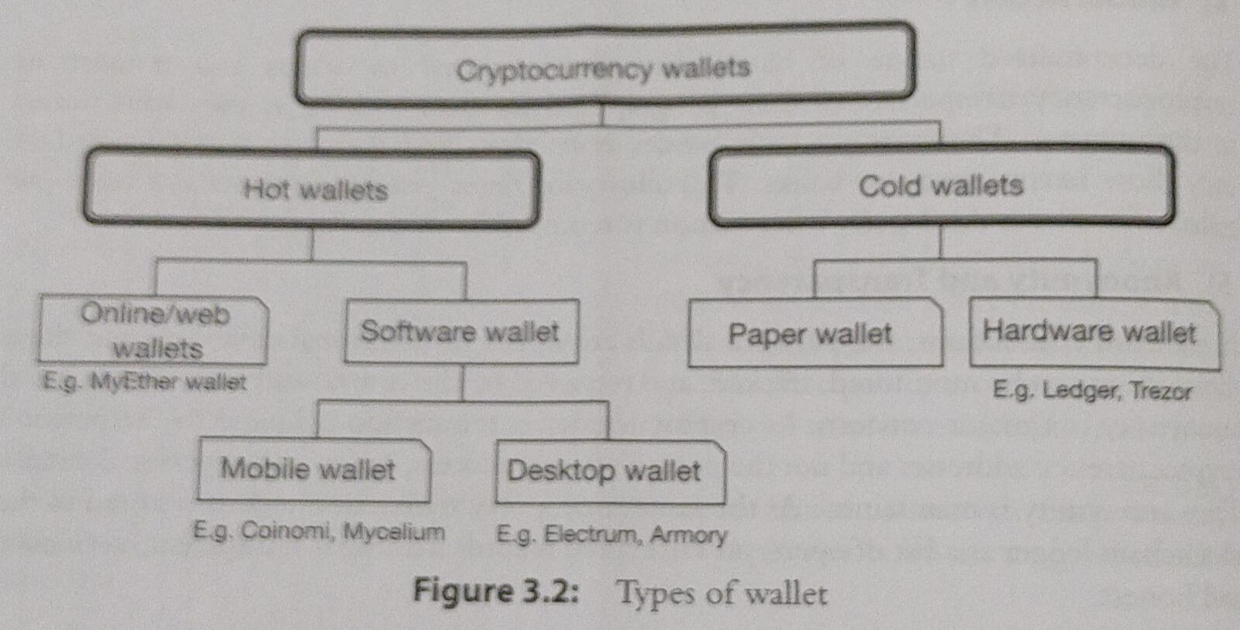

Slide 14
Cryptocurrency Wallet: Software Program that stores the user’s public and private
Keys enabling the user to transmit crypto assests.
HOT WALLET: Online day to day transactions. It is connected to Internet.
Deskstop wallet, Mobile Wallet, Online Wallet
COLD WALLET: It is not connected to the internet and it is not free. They are used it for long
time storage.

Slide 15
Type of Cryptocurrency:
ALTCOIN, TOKEN
Crypto Mining:
SOLO MINING: Miners work independently to mine the block
POOL MINING: Group of miners join collectively
CPU MINING: Miner utilises CPU to mine the cryptocurrency
CLOUD MINING: MINER rents out cloud mining services to other miners for pre assigned period

Slide 16
Year | Name | Description
2009 | Bitcoin | First c.c. used SHA- 256 as hashing function
April 2011 | Name coin | Decentralized DNS
Oct 2011 | Litecoin | First successful script cryptocurrency
2012 | Peercoin | First use of POW and POS functions
Early 2014 | Monero | Uses CryptoNote Protocol ,
2015 | Capricoin | Improved and more user Friendly

Slide 17
